Slide 1
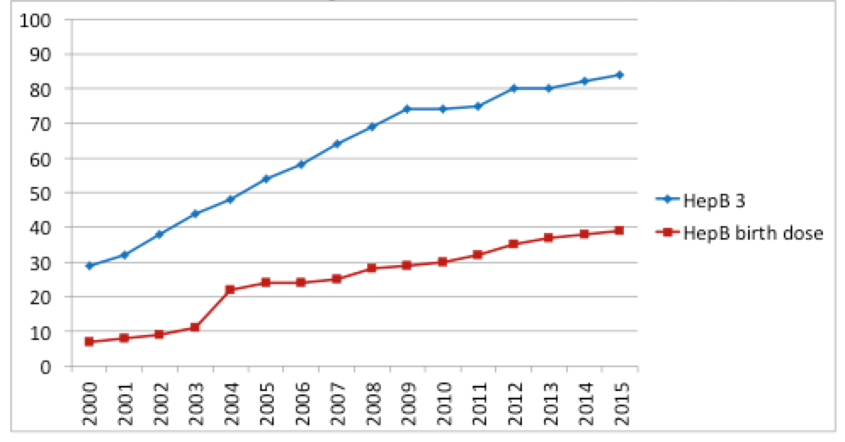
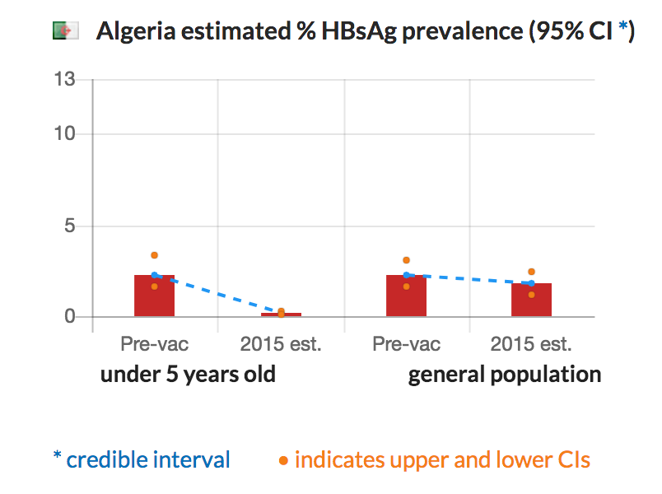
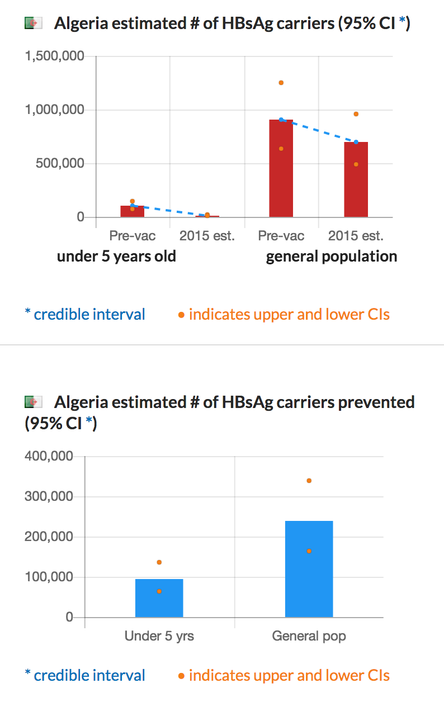
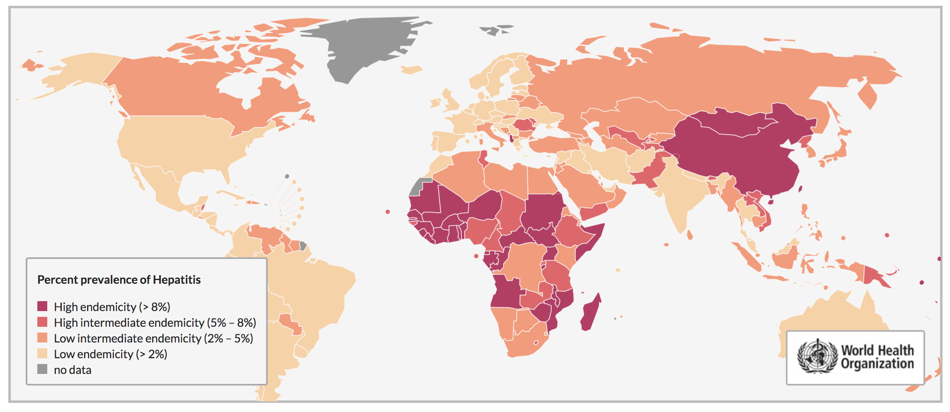
STATUS OF HEPATITIS B: FIRST FIVE YEARS OF LIFE – A CRITICAL TIME TO PREVENT CHRONIC HEPATITIS B INFECTION
FrontPage
Strategy
Burden of Disease
Vaccine
Systematic Review & Model
Global Immunization 3rd dose of Hepatitis B (HepB3) coverage in infants and Birth Dose of Hepatitis B in newborns, 2000-2015
01_Introtext.doc
Global
Please remove dotted lines
Global
Global
Disclaimer

Slide 2
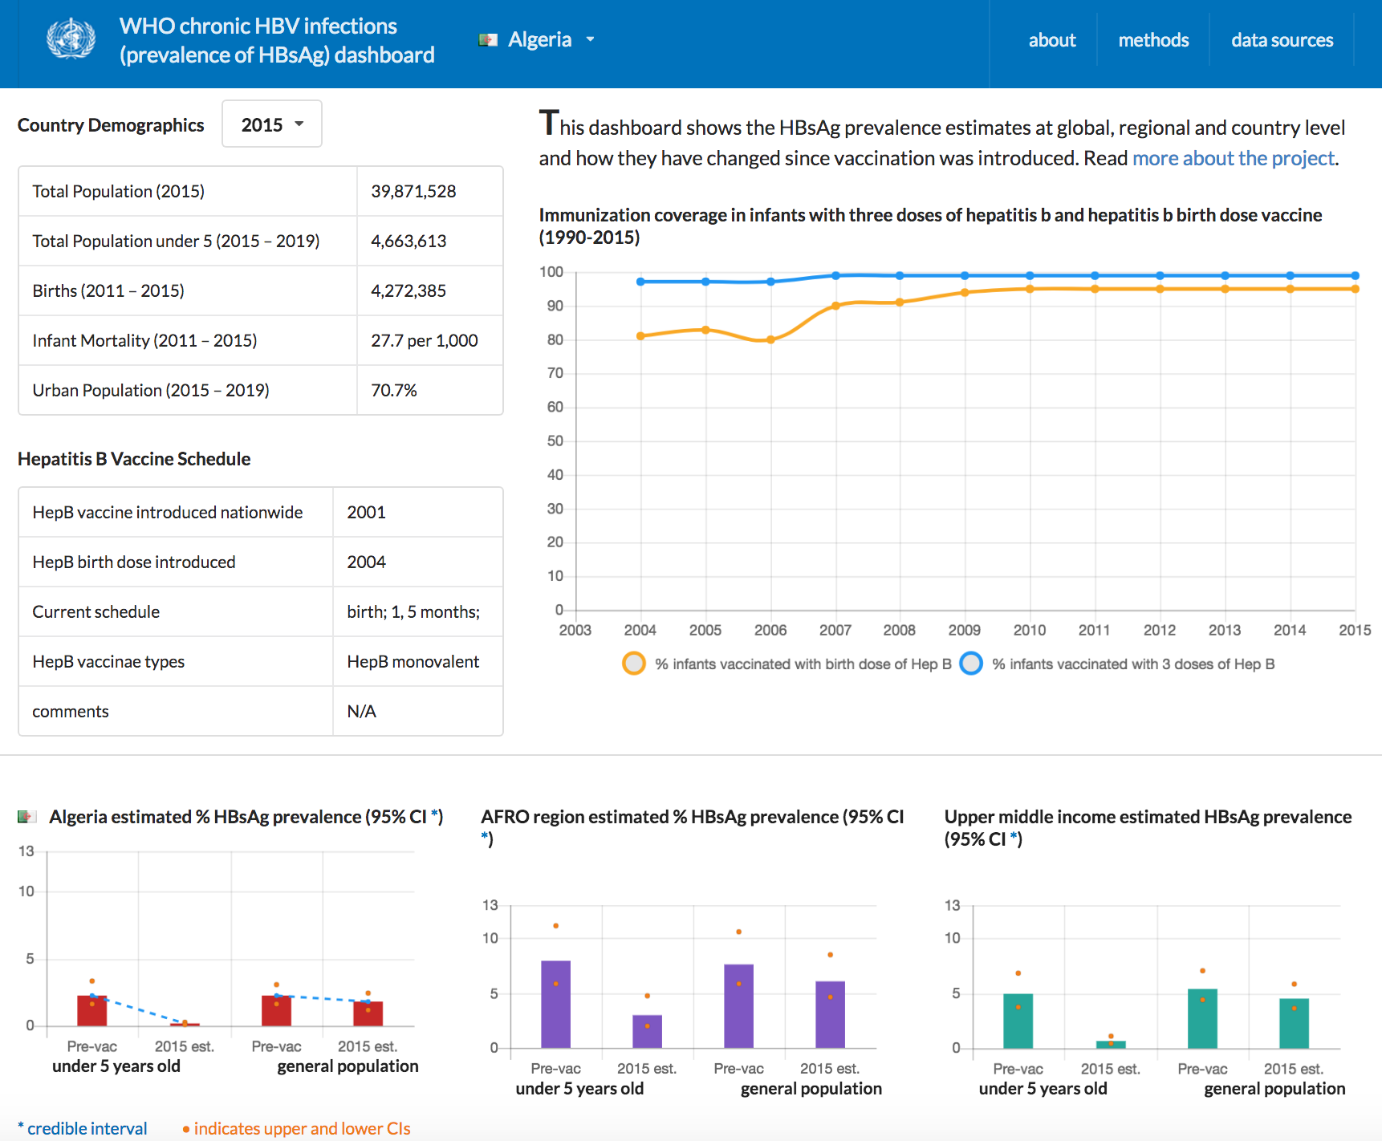
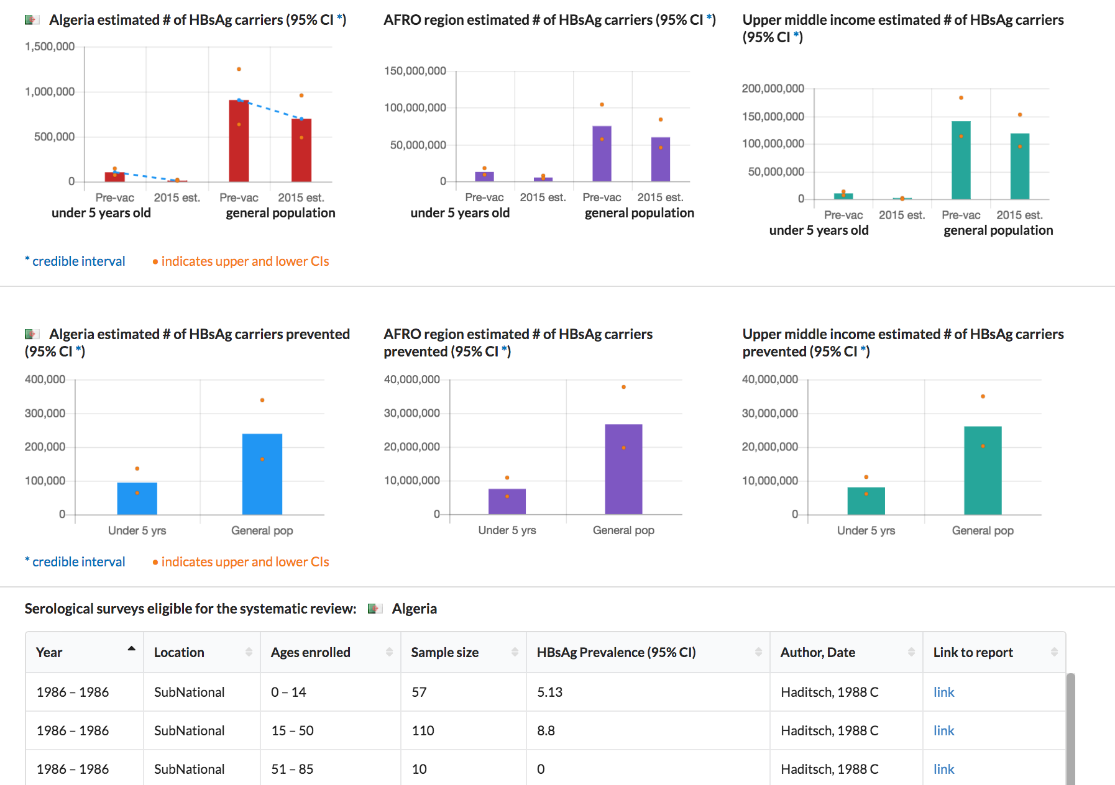
Burden of Disease Page
02_BODtext.doc
Can we have a drop down option for regions
AFR
EMR
EUR
PAHO/AMR
SEAR
WPR
Please remove dotted lines
And add the CI lines

Slide 3
Strategy Page
03_Strategytext.doc

Slide 4
Systematic Review & Model Page
04_Methodstext.doc

Slide 5
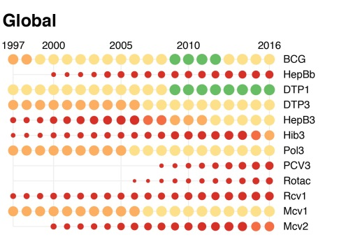
Vaccine Page
05_Vaccinetext.doc

